Slide 1

What Is Your Secret?
Pornhub Big Data Analysis Year by Year
By Zhaohan Yan

Slide 2


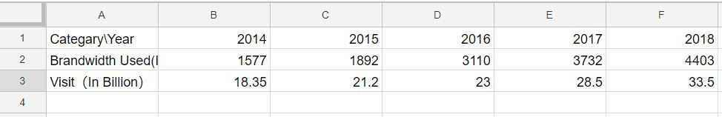
Data Prepare
Data Sources: https://www.pornhub.com/insights/
Anally report.
Data Prepare:
Format: .xlsx
I uploaded my dataset to Kaggle: https://www.kaggle.com/zhaohany/pornhub-analysis-year-by-year

Slide 3
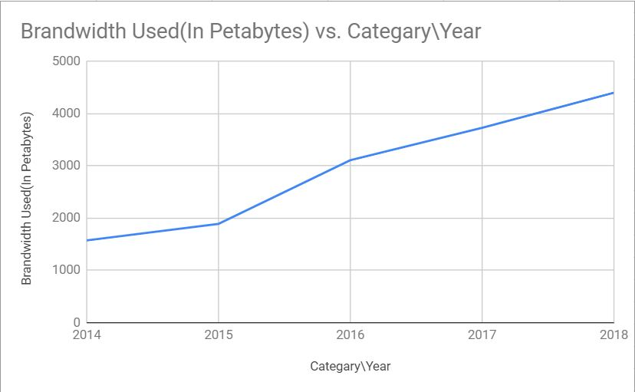
Data Virtualization
Plot data:
Brandwidth Used(In Petabytes)

Slide 4
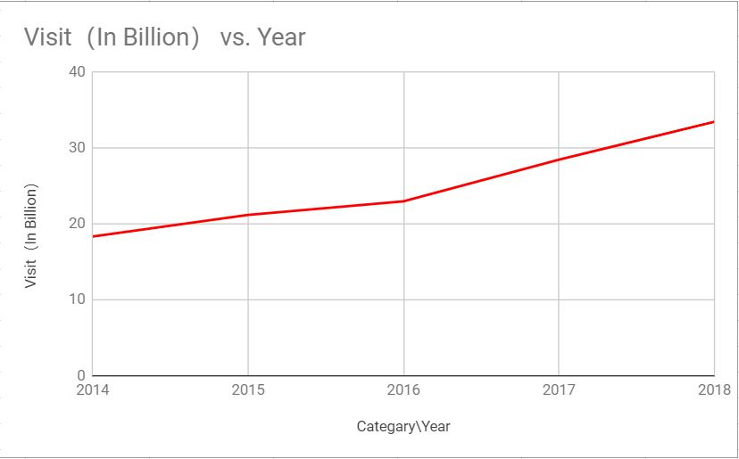
Data Virtualization
Plot data:
2. Visit（In Billion）

Slide 5
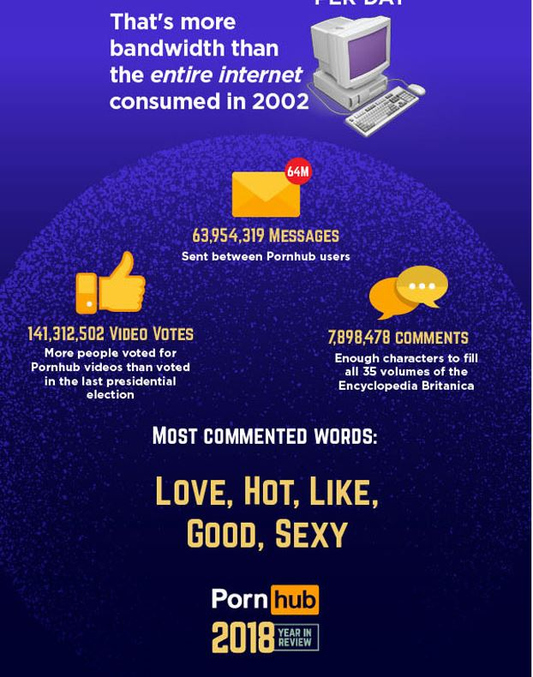
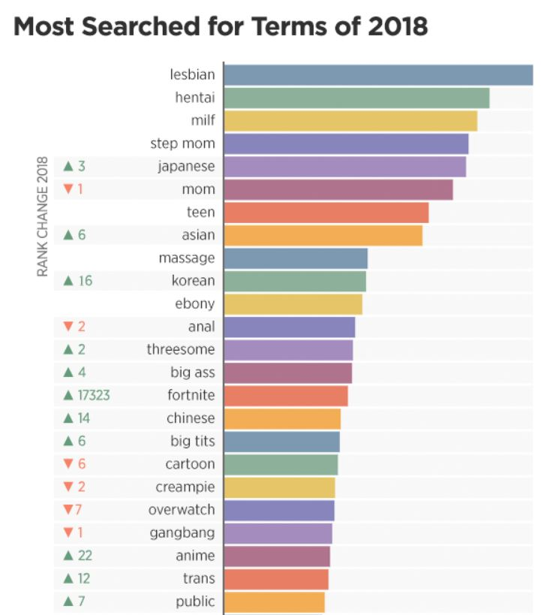
How to use this data?
Advertisement
Yearly report
Development guide

Slide 6
Why is this data interesting?
Although sex is a sensitive topic in nowaday society, people are embarrassed to openly talk or tell others to watch pornography, but big data tells us that there are more people watching porn, people have this demand and industrial development in this area has huge potential.

Slide 7
Sources:
https://www.pornhub.com/insights/2014-year-in-review
https://www.pornhub.com/insights/pornhub-2015-year-in-review
https://www.pornhub.com/insights/2016-year-in-review
https://www.pornhub.com/insights/2017-year-in-review
https://www.pornhub.com/insights/2018-year-in-review
https://www.pornhub.com/insights/10-years
https://www.kaggle.com/zhaohany/pornhub-analysis-year-by-year

Slide 8
What is your secret?
By Zhaohan Yan
Thank you

